Slide 1
The Parts of a Computer
Cheltenham Courseware

Slide 2
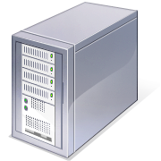
System Unit
The main PC box which houses the various elements which go together to make up the PC.
Contains items such as the computer memory, hard disk and DVD drives.

Slide 3
System or Mother board
Contained within your system unit
The CPU is normally housed on your system board
Items such as the hard disk are attached to the system board, either directly or via cables.

